Slide 1
Cluster Analysis ——Grid-Based Methods——
徐华
清华大学 计算机系 智能技术与系统国家重点实验室
xuhua@tsinghua.edu.cn

Slide 2
Cluster Analysis
What is Cluster Analysis?
Types of Data in Cluster Analysis
A Categorization of Major Clustering Methods
Partitioning Methods
Hierarchical Methods
Density-Based Methods
Grid-Based Methods
Model-Based Clustering Methods
Outlier Analysis
Summary

Slide 3
Grid-Based Clustering Method
Using multi-resolution grid data structure
Several interesting methods
STING (a STatistical INformation Grid approach) by Wang, Yang and Muntz (1997)
WaveCluster by Sheikholeslami, Chatterjee, and Zhang (VLDB’98)
A multi-resolution clustering approach using wavelet method
CLIQUE: Agrawal, et al. (SIGMOD’98)

Slide 4
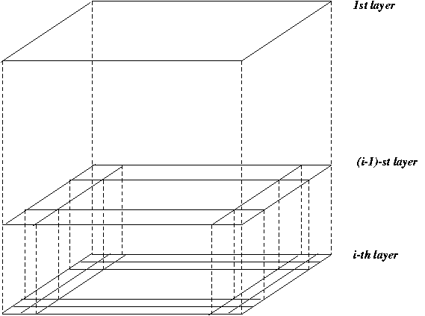
STING: A Statistical Information Grid Approach
Wang, Yang and Muntz (VLDB’97)
The spatial area is divided into rectangular cells
There are several levels of cells corresponding to different levels of resolution

Slide 5
STING: A Statistical Information Grid Approach
Each cell at a high level is partitioned into a number of smaller cells in the next lower level
Statistical info of each cell is calculated and stored beforehand and is used to answer queries
Parameters of higher level cells can be easily calculated from parameters of lower level cell
count, mean, s, min, max
type of distribution—normal, uniform(均匀), etc.
Use a top-down approach to answer spatial data queries
Start from a pre-selected layer—typically with a small number of cells
For each cell in the current level compute the confidence interval

Slide 6
STING: A Statistical Information Grid Approach
Remove the irrelevant cells from further consideration
When finish examining the current layer, proceed to the next lower level
Repeat this process until the bottom layer is reached
Advantages:
Query-independent, easy to parallelize, incremental update
O(K), where K is the number of grid cells at the lowest level
Disadvantages:
All the cluster boundaries are either horizontal or vertical, and no diagonal（对角线的） boundary is detected

Slide 7
Thanks！
Notes:
工作新意图发现

